Slide 1

CLINICAL
CASE STUDY
Eisenhower Medical Center

Slide 2
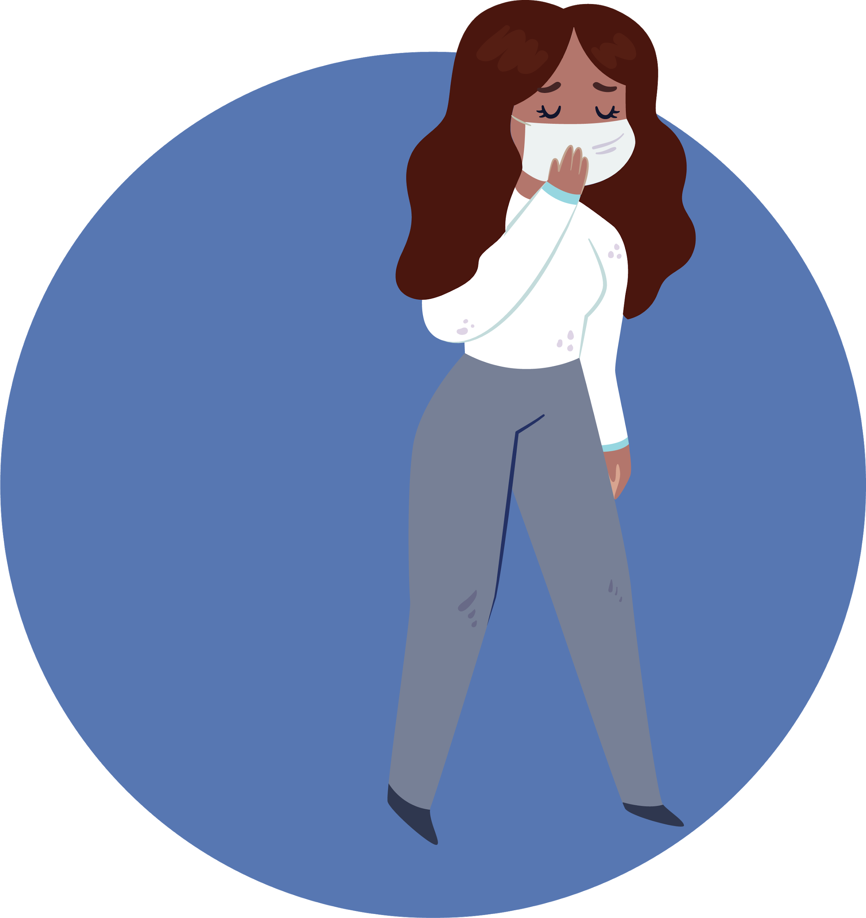

Situation
87 y/o female diagnosed with pneumonia, sepsis and acute hypoxic respiratory failure. Current respiratory orders include DuoNeb, and oxygen therapy. Hemoglobin of 9.5, WBC 23.1, spo2 91% 4L/m. Last ABG 7.41, 38, 75, 24. Imaging showed consolidation, ground glass opacities, artery calcification, mild cardiomegaly, bronchograms scattered throughout, and granulomas.

Slide 3

BACKGROUND
Patient came into ER complaining of SOB. Patient says symptoms started 10 days ago, had fever and cough. Apparently, patient had gone to another hospital and was given ceftriaxone. Her symptoms continued to worsen. Now she is having significant trouble breathing which is constant and moderate intensity. Worse with motion and better with rest. Patient smoked for 21.1 years and quit in 1991. History of chronic blood clots and PEs. Stage 3 kidney injury and diabetes. Patients home medications include Insulin, Famotidine, Tylenol, Coumadin, Eliquis, and Lovenox.

Slide 4

Current Medications
Azithromycin - Antibiotic - Pneumonia
Ceftriaxone - Antibiotic - Pneumonia
Prednisone - Corticosteroid
Insulin - Diabetes
Famotidine - Acid reducer- GERD
Coumadin - Blood thinner - clots
Eliquis - Blood thinner - clots
Lovenox - Blood thinner - clots
Benzonatate - cough syrup - pneumonia
Current Respiratory Orders
DuoNeb 3 mL q6h SVN - Pneumonia
Nasal Cannula 3L/min- continuous - Low Pao2

Slide 5

ABG and Interpretation
pH
PaO2
7.41
38
76
24.6
PaCO2
HCO3
Pt was on 36% FiO2 when drawn
Normal ABG with mild hypoxemia.
No changes were made based off ABG.

Slide 6
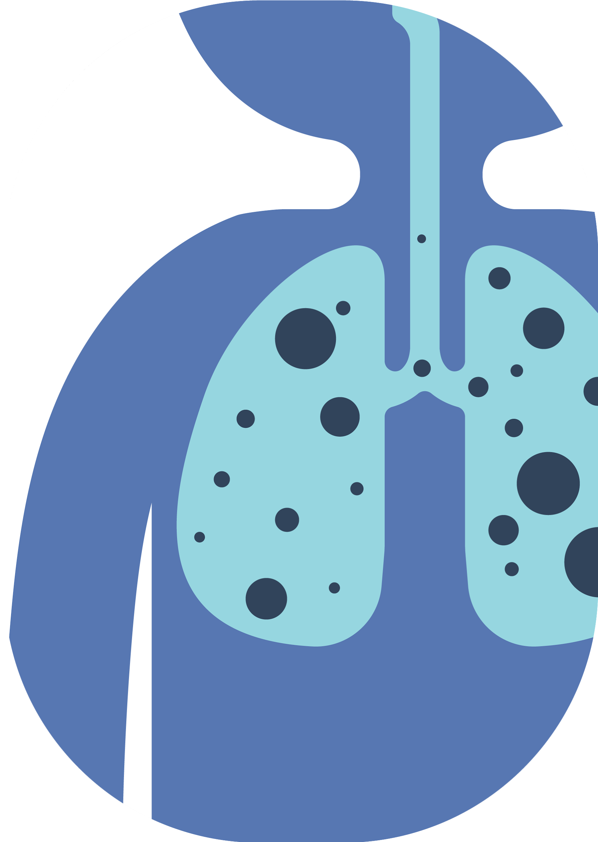

IMAGING RESULTS
X-RAY:
Atelectatic changes seen in the bases. Mild cardiomegaly.
CT SCAN:
Ground glass opacities. Artery calcification. air bronchograms scattered throughout, left lung is mostly affected. Scattered calcified granulomas, fat containing right bochdalek hernia.

Slide 7

Abnormal Lab Findings
WBC
HEMOGLOBIN
BNP
CALCIUM
ALBUMIN
BLOOD SUGAR
23.1 H
PNEUMONIA
9.5 L
ANEMIA
108 H
CONGESTIVE HEART FAILURE
8.0 H
POOR KIDNEY FUNCTION
3.2 L
HIGH INFLAMMATION
177 H
DIABETES

Slide 8

DIAGNOSTIC ASSESSMENT
CaO2
P/F ratio
A-a gradient
14.19 L
Low due to low hemoglobin and hypoxemia
208 L
Mild ARDS due to pneumonia creating V/Q Mismatch
134.2 H
V/Q Mismatch due to pneumonia

Slide 9




Physical Assessment
Progress note:
Patient seems to be improving on current therapies and medications. WBC decreased to 15.2 and oxygen has been titrated to 3L/m. Spo2 95%.
Patient improved when given DuoNeb and cough syrup. Patient stated that she felt much better after her SVN treatment. Patient’s WOB and SOB lessened, and breath sounds improved.
Tripoding
SpO2 / FiO2
Peripheral Edema
Breath sounds
WOB and accessory muscle use were noted. Tripoding while sitting in chair
91%
36% FIO2
Pedal edema due to CHF & kidney injury.
Intake: 2.3L
Out: 650ml
Coarse crackles and rhonchi due to COPD exacerbation, fluid overload and pneumonia

Slide 10

Critical Findings
Severe Cough - Due to pneumonia
Severe chest wall pain - Due to pneumonia
Tripoding - Secondary to COPD exacerbation and pneumonia
Accessory Muscle Use - Increased WOB due to pneumonia and COPD
Low PaO2 - Due to pneumonia and atelectasis
Air bronchograms - Due to ATX and pulmonary edema
Pedal edema - Due to fluid overload secondary to CHF
Fever - Secondary to sepsis
P/F ratio = Mild ARDS - Due to pneumonia, COPD exacerbation
Low urine output - Secondary to kidney disease and CHF
Legionnaires - Finding indicate cause of severe pneumonia.
Hypoxic Resp. Failure - Due to pneumonia and COPD
CT scan - Ground glass opacities scattered throughout - indicates pneumonia

Slide 11

RECOMMENDATIONS
2. Incentive Spirometry: Reduce atelectasis. Help mobilize secretions.
1. MetaNeb with breathing treatments: Mobilize thick secretions due to pneumonia and COPD exacerbation
3. Begin long acting inhaler regimen for COPD
5. Lasix: To reduce fluid overload due to kidney disease and CHF
4. Evaluate patient for home O2 requirement

Slide 12

WHAT I LEARNED
I learned that Legionnaires’ disease is a rare and severe form of pneumonia and can easily exacerbate comorbidities. I also learned that patients could present in acute distress and have a normal ABG. Quality patient assessment is very important for appropriate care of our patients.

